Slide 1
If 2012 is the end of the world……
Where do you want to go?

Slide 3
Journey to Tibet!
China Study Society, HKUSU
Tibet Study Trip

Slide 4
Why Join Us?
Bring along your passion and join China Study Society’s summer study trip to Tibet.
Don’t miss this precious opportunity to visit mysterious Tibet and participate in various other activities.
The journey will be an unforgettable and unique experience.

Slide 5
HIGHLIGHTS
Train trip from Xining, Qinghai Province to Lhasa, Tibet enjoying the most amazing landscape in China.
Joining the lectures given by professors from Tibet University and exchanging ideas with local students.
Visiting religious and historical sites in Lhasa
Going to the only school for blind children in Lhasa, communicating with the teachers and students and doing the voluntary teaching.
Sightseeing the “Heavenly Lake” Lake Nam in Namtco

Slide 6
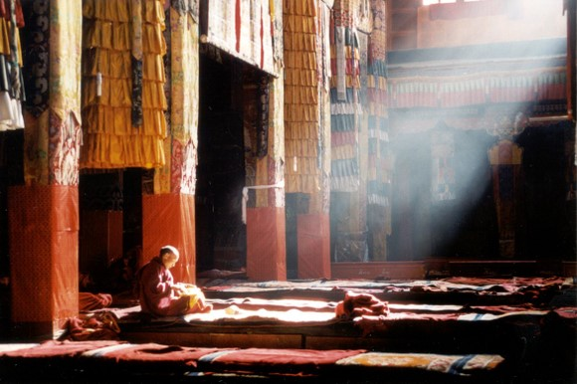
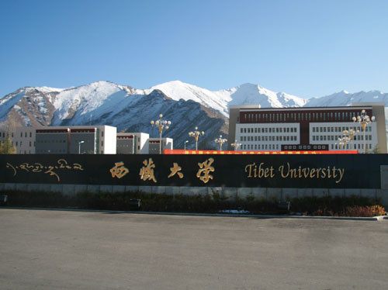

Slide 7
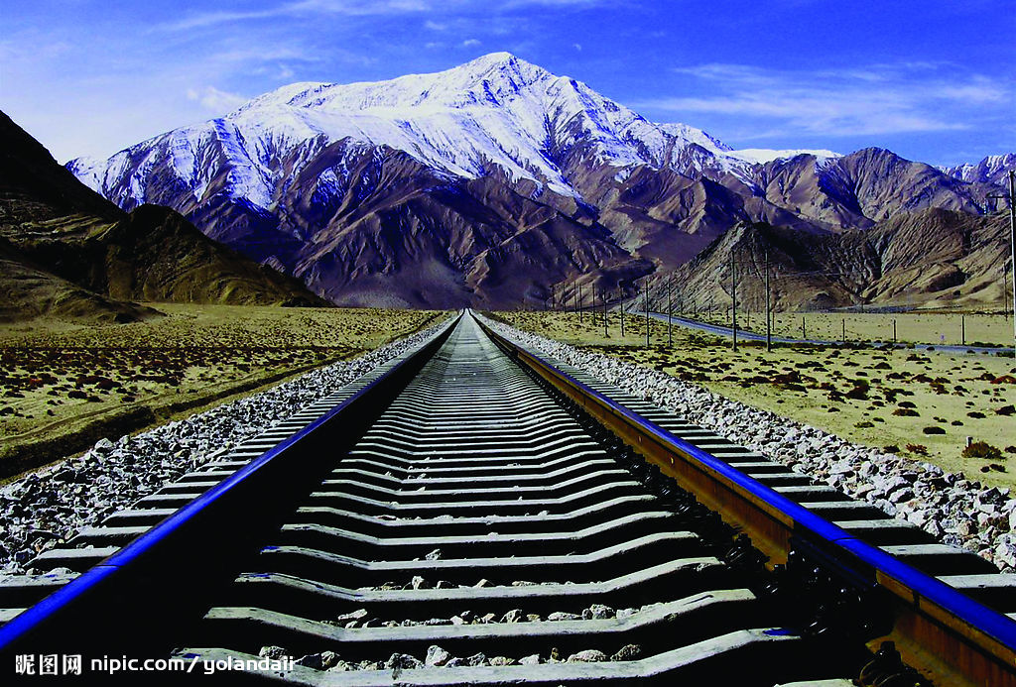

Slide 8
Important Dates
Mar. 30th : Deadline for online
registration http://www.hku.hk/css/registration.html
Apr. 1st~Apr. 5th : An interview if
Necessary (Due to the limited quota)
Apr. 14th~Apr. 17th: 1st workshop for participants.
May 16th~May 18th : 2nd workshop for participants.
May 27th: Leaving for Tibet

Slide 9
Workshops for participants
Two workshops will be arranged.
Basic information about Tibet and Tibet related issues will be introduced in the workshop.
Recommended movies and reading lists will be provided.
Skype with students and teachers from the blind school in Tibet.

Slide 10
FAQ
What about the fee of the trip?
The total fee would be around 5000RMB(6300HKD). The cost will be confirmed after the booking of flight tickets.
Who can take part in the activity?
Those who have a strong interest in Tibet’s culture and related issue are all welcomed!
A good health condition is also required.
Due to the number of application, an interview session will be arranged.

Slide 11
FAQ
Is it safe to travel to Tibet? We co-operate this project with a Tibetan local agency. Experienced driver and local guide will be along with us through the entire journey.
What documents do I need?
We will help you get the Tibet Entry Permit.
Those who do not hold a Chinese passport should apply for a Chinese visa themselves.

Slide 12
Let’s Enjoy the Movie!

